Slide 1
Data Abstraction: The Walls
Chapter 1
Data Structures and Problem Solving with C++: Walls and Mirrors, Carrano and Henry, © 2013

Slide 2
Contents
Object-Oriented Concepts
Achieving a Better Solution
Specifications
Abstract Data Types
The ADT Bag
Data Structures and Problem Solving with C++: Walls and Mirrors, Carrano and Henry, © 2013

Slide 3
Object-Oriented Concepts
Code using a solution design
Specify a system of interacting objects
Object-oriented analysis specifies
  What to do
  Not how to do it
Object-oriented design specifies
  Models of how it might be done
Data Structures and Problem Solving with C++: Walls and Mirrors, Carrano and Henry, © 2013

Slide 4
Object-Oriented Solution
Create a good set of modules
  Store, move, alter data
  Communicate with one another
Use classes of objects
  Combines attributes and behaviors
Data Structures and Problem Solving with C++: Walls and Mirrors, Carrano and Henry, © 2013

Slide 5
Principles of Object-Oriented Programming
Encapsulation: Objects combine data and operations.
Inheritance: Classes inherit properties from other classes.
Polymorphism: Objects determine appropriate operations at execution.
Data Structures and Problem Solving with C++: Walls and Mirrors, Carrano and Henry, © 2013

Slide 6
Achieving a Better Solution
Cohesive modules perform single well-defined tasks
Coupling – measure of dependence among modules
  Loosely coupled modules desired
Data Structures and Problem Solving with C++: Walls and Mirrors, Carrano and Henry, © 2013

Slide 7
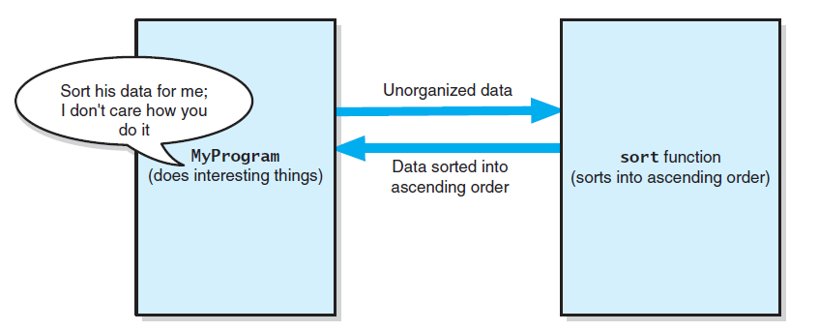
Achieving a Better Solution
FIGURE 1-1 The task sort is a module separate from the MyProgram module
Data Structures and Problem Solving with C++: Walls and Mirrors, Carrano and Henry, © 2013

Slide 8
Operation Contract
Documents use and limitations of a method
Specifies data flow
Does not specify how module will perform its task
Specifies pre- and post-conditions
Data Structures and Problem Solving with C++: Walls and Mirrors, Carrano and Henry, © 2013

Slide 9
Unusual Conditions
Options
Assume they never happen
Ignore invalid situations
Guess at client’s intent
Return value that signals a problem
Throw an exception
Data Structures and Problem Solving with C++: Walls and Mirrors, Carrano and Henry, © 2013

Slide 10
Abstraction
Separates purpose of a module from its implementation
Possible to use a module without knowing implementation
Think “what” not “how”
Data Structures and Problem Solving with C++: Walls and Mirrors, Carrano and Henry, © 2013

Slide 11
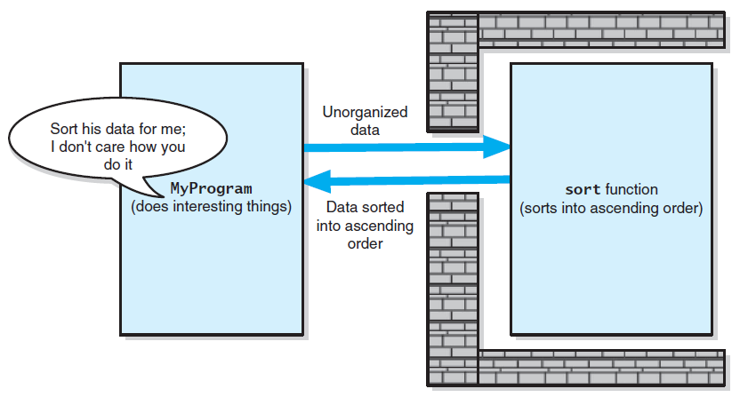
Information Hiding
FIGURE 1-2 Tasks communicate through a slit in wall
Data Structures and Problem Solving with C++: Walls and Mirrors, Carrano and Henry, © 2013

Slide 12
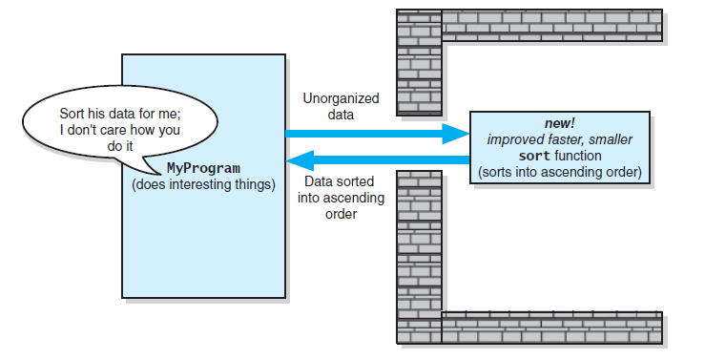
Minimal and Complete Interfaces
FIGURE 1-3 A revised implementation communicates through the same slit in the wall
Data Structures and Problem Solving with C++: Walls and Mirrors, Carrano and Henry, © 2013

Slide 13
Abstract Data Type
A collection of data and
A set of operations on the data.
Carefully specify an ADT’s operations before you implement them
Data Structures and Problem Solving with C++: Walls and Mirrors, Carrano and Henry, © 2013

Slide 14
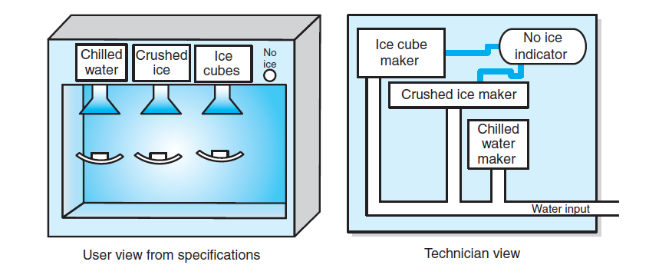
Abstract Data Type
FIGURE 1-4 A dispenser of chilled water,
crushed ice, and ice cubes
Data Structures and Problem Solving with C++: Walls and Mirrors, Carrano and Henry, © 2013

Slide 15
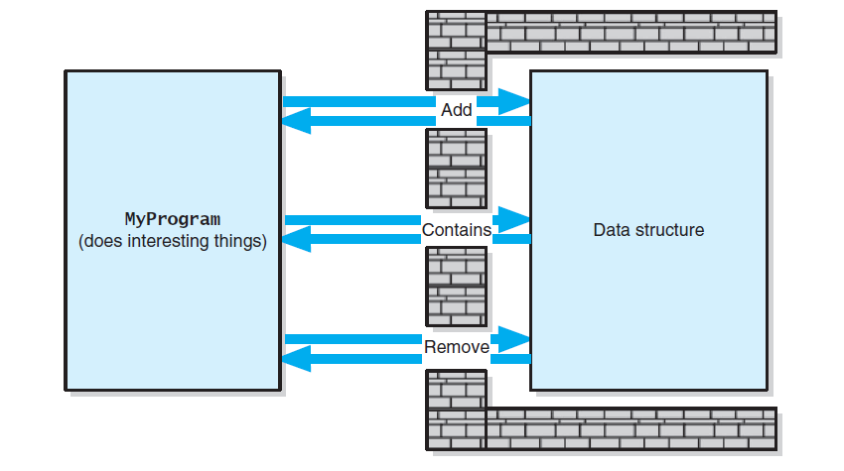
Abstract Data Type
FIGURE 1-5 A wall of ADT operations isolates a data structure from the program that uses it
Data Structures and Problem Solving with C++: Walls and Mirrors, Carrano and Henry, © 2013

Slide 16
Designing an ADT
Ask the questions
What data does the problem require?
  Names
  IDs
  Numerical data
What operations will be done on that data?
  Initialize
  Display
  Calculations
Data Structures and Problem Solving with C++: Walls and Mirrors, Carrano and Henry, © 2013

Slide 17
The ADT Bag
A bag is a container
  Contains finite number of data objects
  All objects of same type
  Objects in no particular order
  Objects may be duplicated
Data Structures and Problem Solving with C++: Walls and Mirrors, Carrano and Henry, © 2013

Slide 18
Identifying Behaviors
Get the number of items currently in the bag.
See whether the bag is empty.
Add a given object to bag.
Remove occurrence of specific object from bag
Remove all objects from bag.
Data Structures and Problem Solving with C++: Walls and Mirrors, Carrano and Henry, © 2013

Slide 19
Identifying Behaviors
Count the number of times certain object occurs in bag.
Test whether bag contains particular object.
Look at all objects in bag.
Data Structures and Problem Solving with C++: Walls and Mirrors, Carrano and Henry, © 2013

Slide 20
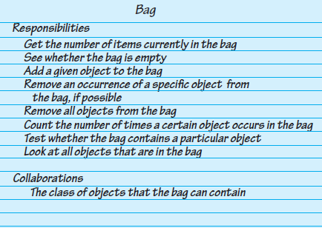
Identifying Behaviors
FIGURE 1-6 A CRC card for a class Bag
Data Structures and Problem Solving with C++: Walls and Mirrors, Carrano and Henry, © 2013

Slide 21
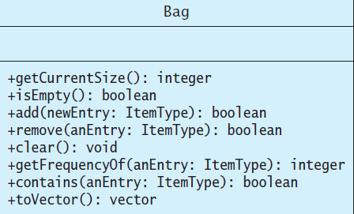
Specifying Data and Operations
FIGURE 1-7 UML notation for the class Bag
Data Structures and Problem Solving with C++: Walls and Mirrors, Carrano and Henry, © 2013

Slide 22
The ADT Bag
View code listing for Bag interface,
  Listing 1-1
Note use of ADT Bag, Program for Card Guessing
  Listing 1-2
.htm code listing files must be in the same folder as the .ppt files for these links to work
Data Structures and Problem Solving with C++: Walls and Mirrors, Carrano and Henry, © 2013

Slide 23
End
Chapter 1
Data Structures and Problem Solving with C++: Walls and Mirrors, Carrano and Henry, © 2013

